Slide 1
From Atomic IDs to Semantic IDs: Disentangling Compression, Adaptation, and Scoring in Recommendation
Headline message:
"Semantic IDs save parameters, but under a fair comparison they don't improve accuracy"
Findings:
Apparent SID model gains come from training, not the IDs. Semantic IDs can look like an improvement, but much of that gain comes from the extra training they get.
Compression has a price. Swapping item embeddings for shared codes reduced recommendation performance. Training the codes on the recommendation task wins most of that back, but never all of it.
SIDs help rare items when used to score candidates at a cost to popular items.

Slide 2
Why we need a fair evaluation of SID models
What Semantic IDs promise?
Why direct comparison with Atomic ID models isn't fair?
1. Fewer parameters
2. Competitive accuracy
3. Help for rare/unseen items
Too much changes at once:
  - the backbone,
  - the training budget,
  - sequence representation
  - output paramterisation
Codes play two different roles:
  - in the user history (input side): SIDs change what the models sees when it encodes user preferences
  - for candidate scoring (output/scoring side): SIDs change how items are told apart and how training signal spreads accross them

Slide 3
Reported improvements in overall performance cannot be attributed to SIDs alone
REPORTED
WHAT ACTUALLY CHANGED AT ONCE
Atomic-ID model SID model
Input representation (IDs codes)
Output space (rank a table generate codes)
Parameter count and where it sits
Training procedure and budget
History length that fits in the window
+20%
Recall@10. Our own reproduction: SASRec 0.053 TIGER 0.065.
Any of the five changes could produce +20%. The comparison cannot tell you whether the codes did anything.

Slide 4
How SASRec scores the next item
Query q
Scoring table E: one row per item
q · every row
Item
Embedding (64-d)
Score
Transformer (2 blocks, causal attention) -> W
item 1
e₁
q · e₁
self-attention + feed-forward blocks
item 2
e₂
q · e₂
item 3
e₃
q · e₃ highest
⋮
Scoring table
item V
e_V
q · e_V
E[i] + P[pos]
E[i] + P[pos]
E[i] + P[pos]
E[i] + P[pos]
Softmax over all items → top-10 list
Trained with cross-entropy on the true next item
item 1
item 2
item 3
item 4
Input (user history)

Slide 5




How SASRec scores the next item (SID on input)
Query q
Scoring table E: one row per item
q · every row
Item
Embedding (64-d)
Score
Transformer (2 blocks, causal attention) -> W
item 1
e₁
q · e₁
self-attention + feed-forward blocks
item 2
e₂
q · e₂
+ LoRA (r = 4)
item 3
e₃
q · e₃ highest
⋮
Scoring table
item V
e_V
q · e_V
$\sum_{l}{C_{l}[c_{i,l}]}$ +P[pos]
$\sum_{l}{C_{l}[c_{i,l}]}$ +P[pos]
$\sum_{l}{C_{l}[c_{i,l}]}$ +P[pos]
$\sum_{l}{C_{l}[c_{i,l}]}$ +P[pos]
Softmax over all items → top-10 list
Trained with cross-entropy on the true next item
$$c_{1,1}$$
$$c_{1,2}$$
$$c_{1,3}$$
$$c_{1,4}$$
$$c_{2,1}$$
$$c_{2,2}$$
$$c_{2,3}$$
$$c_{2,4}$$
$$c_{3,1}$$
$$c_{3,2}$$
$$c_{3,3}$$
$$c_{3,4}$$
$$c_{4,1}$$
$$c_{4,2}$$
$$c_{4,3}$$
$$c_{4,4}$$
item 1
item 2
item 3
item 4
Subsequent models can only win by understanding user history better
Input (user history)

Slide 6







How SASRec scores the next item (SID on input)
Query q
Scoring table E: one row per item
q · every row
Item
Embedding (64-d)
Score
Transformer (2 blocks, causal attention) -> W
item 1
e₁
q · e₁
self-attention + feed-forward blocks
item 2
e₂
q · e₂
+ LoRA (r = 4)
item 3
e₃
q · e₃ highest
⋮
Scoring table
item V
e_V
q · e_V
$$C_{1}[c_{1,1}]$$
$$P\left[1\right]$$
$$L[1]$$
$$C_{2}[c_{1,2}]$$
$$P\left[1\right]$$
$$L[2]$$
…
…
$$C_{1}[c_{2,1}]$$
$$P\left[2\right]$$
$$L[1]$$
$$C_{2}[c_{2,2}]$$
$$P\left[2\right]$$
$$L[2]$$
…
…
$$C_{1}[c_{3,1}]$$
$$P\left[3\right]$$
$$L[1]$$
$$C_{2}[c_{3,2}]$$
$$P\left[3\right]$$
$$L[2]$$
…
…
$$C_{1}[c_{4,1}]$$
$$P\left[4\right]$$
$$L[1]$$
$$C_{2}c_{4,2}]$$
$$P\left[4\right]$$
$$L[2]$$
…
…
Softmax over all items → top-10 list
Trained with cross-entropy on the true next item
$$c_{1,1}$$
$$c_{1,2}$$
$$c_{1,3}$$
$$c_{1,4}$$
$$c_{2,1}$$
$$c_{2,2}$$
$$c_{2,3}$$
$$c_{2,4}$$
$$c_{3,1}$$
$$c_{3,2}$$
$$c_{3,3}$$
$$c_{3,4}$$
$$c_{4,1}$$
$$c_{4,2}$$
$$c_{4,3}$$
$$c_{4,4}$$
item 1
item 2
item 3
item 4
Input (user history)

Slide 7








How SASRec scores the next item (SID on input and output)
Query q
Scoring table E: one row per item
q · every row
Item
Embedding (64-d)
Score
Transformer (2 blocks, causal attention) -> W
item 1
$$c_{1,1}$$
$$c_{1,2}$$
$$c_{1,3}$$
$$c_{1,4}$$
$$\sum_{l}{D_{l}[c_{1,l}]}$$
q · $\sum_{l}{D_{l}[c_{1,l}]}$
self-attention + feed-forward blocks
item 2
$$c_{2,1}$$
$$c_{2,2}$$
$$c_{2,3}$$
$$c_{2,4}$$
$$\sum_{l}{D_{l}[c_{2,l}]}$$
q · $\sum_{l}{D_{l}[c_{2,l}]}$
+ LoRA (r = 4)
item 3
$$\sum_{l}{D_{l}[c_{3,l}]}$$
q · $\sum_{l}{D_{l}[c_{3,l}]}$ highest
⋮
Scoring table
item V
$$c_{V,1}$$
$$c_{V,2}$$
$$c_{V,3}$$
$$c_{V,4}$$
$$\sum_{l}{D_{l}[c_{V,l}]}$$
q · $\sum_{l}{D_{l}[c_{V,l}]}$
$\sum_{l}{C_{l}[c_{i,l}]}$ +P[pos]
$\sum_{l}{C_{l}[c_{i,l}]}$ +P[pos]
$\sum_{l}{C_{l}[c_{i,l}]}$ +P[pos]
$\sum_{l}{C_{l}[c_{i,l}]}$ +P[pos]
Softmax over all items → top-10 list
Trained with cross-entropy on the true next item
$$c_{1,1}$$
$$c_{1,2}$$
$$c_{1,3}$$
$$c_{1,4}$$
$$c_{2,1}$$
$$c_{2,2}$$
$$c_{2,3}$$
$$c_{2,4}$$
$$c_{3,1}$$
$$c_{3,2}$$
$$c_{3,3}$$
$$c_{3,4}$$
$$c_{4,1}$$
$$c_{4,2}$$
$$c_{4,3}$$
$$c_{4,4}$$
item 1
item 2
item 3
item 4
Input (user history)

Slide 8
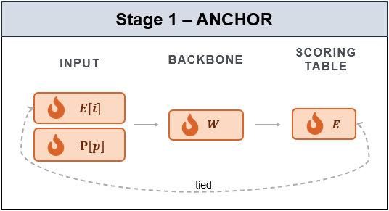
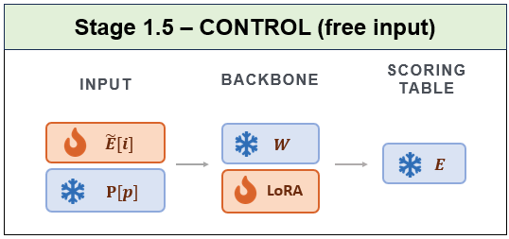
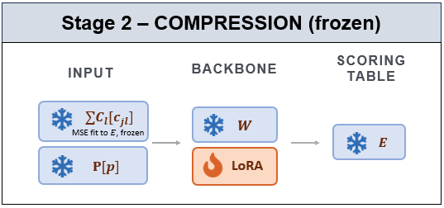
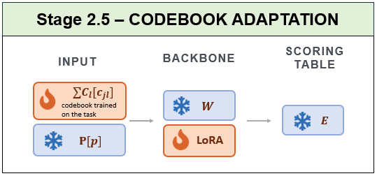
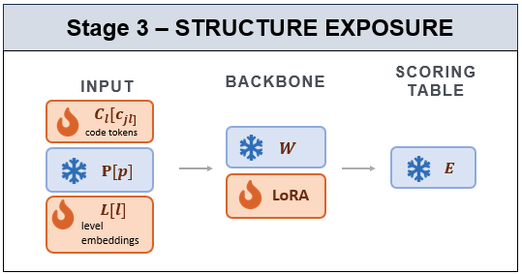
Change one component at a time to isolate SID effects

Slide 9
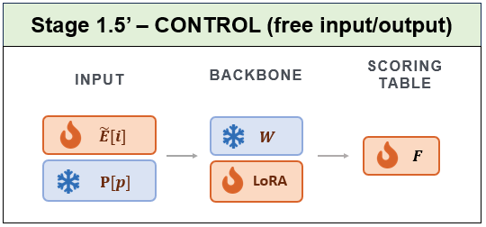
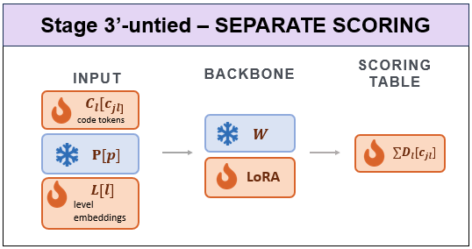
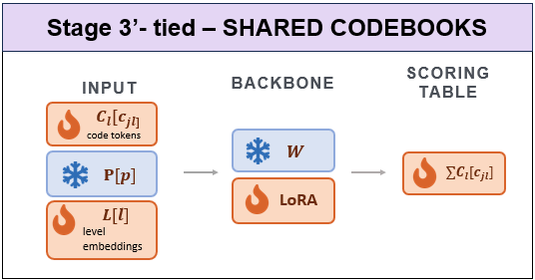
Change one component at a time to isolate SID effects

Slide 10
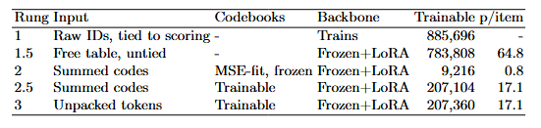
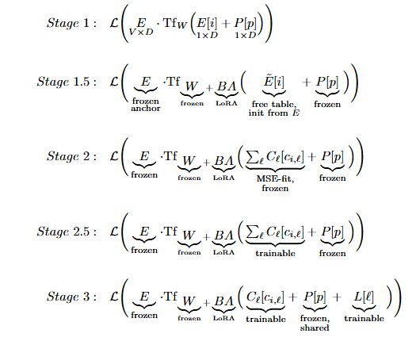
The ladder
Anchor
Control
Isolates compression
Isolates SID effect, codes summed
Isolates SID effect, codes unpacked

Slide 11
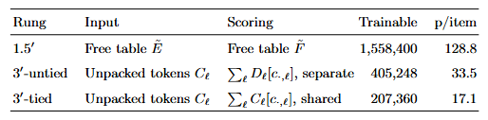
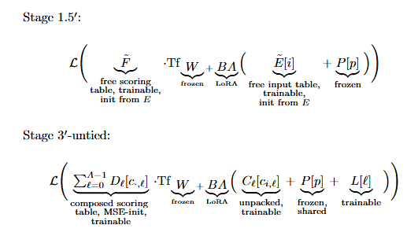
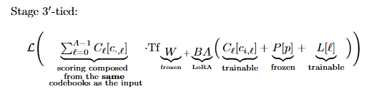
The companion ladder
New Control
Isolates SID effect, input codes unpacked, output codes is sum of separate trainable codebooks
Isolates SID effect, input and output codebooks are the same

Slide 12
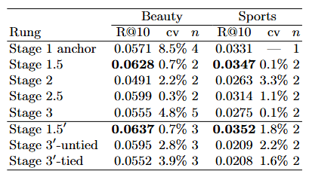
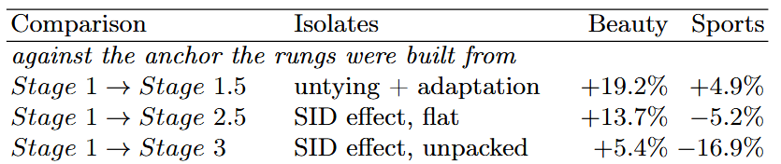
Main results
The free-table control (Stage 1.5) is the best input-side rung on both datasets: 0.0628 on Beauty, 0.0347 on Sports
All Semantic ID models perform below this recall
The companion control, stage 1.5’, is marginally better, so freeing the scoring table slightly improves performance
On the scoring side, untied beats tied
Against the anchor (Stage 1), SIDs look like they outperform it on both datasets
Untying and additional training improves performance by 19.2% on Beauty and 4.9% on Sports

Slide 13
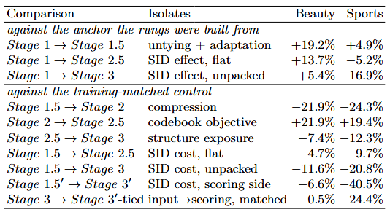
Main results
Against the control (stage 1.5) however, SIDs hurt overall performance
Compression costs 22-24%
SIDs result in decreased performance on both input side and input and scoring side

Slide 14
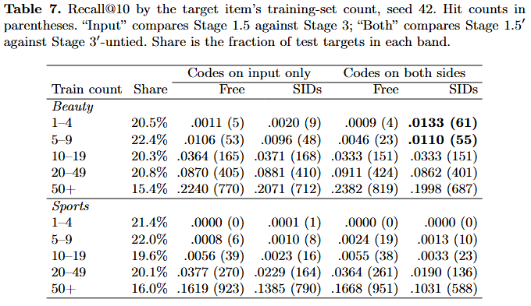
Main results – popularity stratified
Do rare-items benefit from SIDs?
On Beauty, the model with SIDs on both sides retrieves significantly more rare items than a free table on scoring side
However popular item retrieval is reduced for the model with SIDs

Slide 15
Conclusions
End-to-end comparisons between SID based models and Item ID models do not reveal the cost and benefit trade-offs of SIDs
Shared code embeddings reduce parameter requirements but do not always outperform well-optimized Item ID models
Semantic ID models can improve rare-item retrieval but at the expense of popular item retrieval
Comparison between SID based models and Item ID models requires careful component-level comparisons

Slide 16
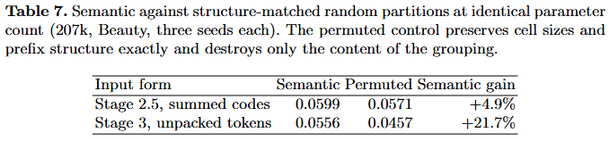

Slide 17
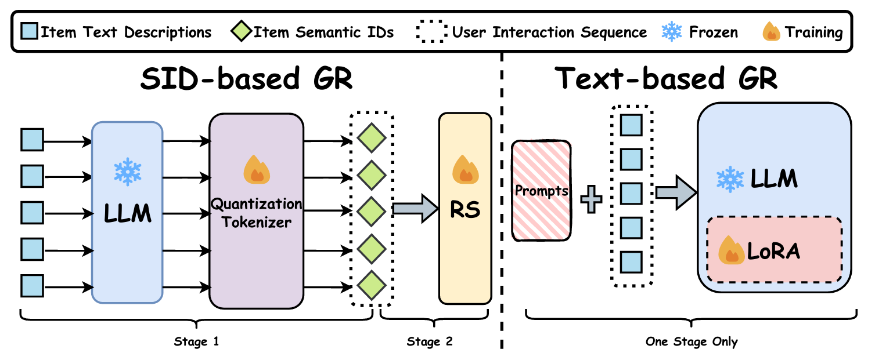
Semantic ID Drift: How to Update Codebooks?
Motivation: Recommending news items in the HQ Browser Newsfeed SID project
Two - stage pipeline:
Use a Qwen model to produce embeddings for news items
Train RQ-VAE codebooks to codebooks
Use the produced Semantic IDs as features (pool the corresponding embeddings) in a downstream CTR model
  Not a generative model
  The downstream CTR model is incrementally trained on new user interactions data

Slide 18
Literature

Slide 19
Literature

Slide 20
How to measure semantic drift

Slide 21
Incremental update strategies

Slide 22
Applying hungarian mapping

Slide 23
Downstream experiments

Slide 24
Research: prefix-based alignment

Slide 25
Research: history-aware updates

